Slide 1
教會建堂計劃 Church Building Project
CBCWLA
April 18, 2010

Slide 2
回顧 Looking back

Slide 3
會堂簡史 A short history of the church building
April 29, 1973: 洛杉磯西區華語浸信會遷入目前的堂址，在餐廳舉行主日崇拜。CBCWLA moved to the current address, met in the dinning room for Sunday services.
Sep. 29, 1974: 開始在二層樓的大堂做禮拜 Begin to worship in the sanctuary of the two-story building

Slide 4
近期發展 Recent development
July, 2008：與企劃經理楊幸浩弟兄及建築師蕭司提反弟兄會面 Met with project manager brother Scott Yang and architect brother Steven Hsiao.
Sep. 28, 2008：會員大會以超過三分之二的票數通過建堂。The motion to build a new church building was passed by over 2/3 votes in a members’ meeting.

Slide 5
Jan. 2009：向市政府提出建築申請 The building plan was submitted to the L.A. city。
Sep. 3, 2009：舉行公聽會 Public hearing.
April 9, 2010：收到建築許可 Received permit (CUP) from the Department of City Planning。

Slide 6
新舊比較 A comparison between the old and new

Slide 7
 | 舊堂 Old | 新堂 New
總面積 total area | 7,300 sf | 14,200 sf
大堂 sanctuary 副堂 overflow room | 1,525 sf 375 sf | 3,182 sf
教室 classrooms | 8 間 rooms, 2,240 sf | 12 間 rooms, 4,310 sf
餐廳 dinning room | 875 sf | 1,417 sf
辦公室 offices | 3 間 rooms, 400 sf | 5 間 rooms, 740 sf
車位 parking | 21 | 44

Slide 8
舊堂 old building |  | 新堂 new building
A203 (嬰) | 290 sf | 206 | 274 sf
A205 (大) | 730 sf | 207 | 251 sf
A206 | 110 sf | 208 | 253 sf
A207 (圖) | 250 sf | 209 | 258 sf
A208 | 110 sf | 210 | 280 sf
A210 | 110 sf | 211 | 969 sf
B101 (牧) | 182 sf | 306 | 241 sf
C101 (彩) | 448 sf | 307 | 244 sf
 |  | 308 | 232 sf
 |  | 309 | 225 sf
 |  | 310 | 177 sf
 |  | 311 | 906 sf
Total | 2,240 sf |  | 4,310 sf

Slide 9
關於財務 About the money

Slide 10
建堂預算 Building project estimate
總額 total cost | $3,885,200
建築費 construction | $3,172,500
軟性項目 soft cost (建築師，工程師，市政府..) | $ 359,500
預備費 contingency | $ 353,200

Slide 11
我們的財務狀況 Our financial situation
我們所有的 what we have: $1,913,000
可動用資產 total usable asset：1,572,000
未履行認獻 Unfulfilled pledge： 341,000
我們需要的 what we need: $3,691,000
建堂預算 project estimate: 3,885,200
已付款額 already paid: 194,200
不足款額 what we’re short of: $1,778,000

Slide 12
建堂認獻與奉獻 Building pledge and offering
認獻 pledge: $484,080
已履行 fulfilled: $142,905
未履行 unfulfilled: $341,175
奉獻 offering: $129,881
總數 total: $613,961
尚需 still need: $1,778,000

Slide 13
感謝主，我們已經獲得了建築許可。Praise the Lord, we already got the CUP (conditional use permit).
是否可以動工，在於是否能夠籌到足夠的款項。When will the construction begin? That depends on when we will raise enough fund.

Slide 14
前瞻 Looking forward

Slide 15
估計日期表 Estimated Timeline
開工日期 ：2011年1月15日 Construction begins: Jan. 15, 2011
施工期間 ：19個月 Construction period: 19 months
完工日期：2012年8月15日 Completion date: Aug. 15, 2012

Slide 16
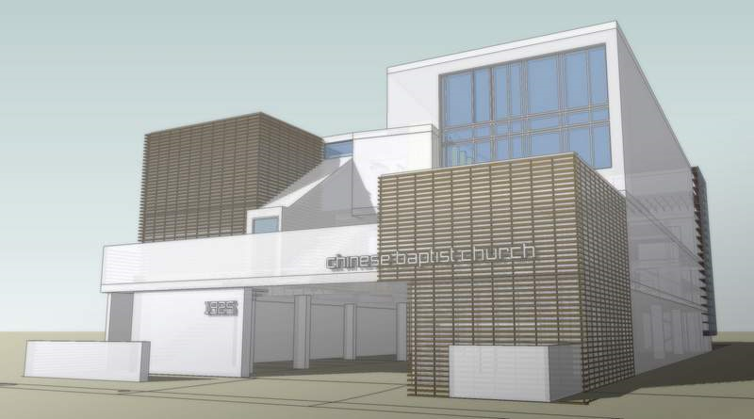

Slide 17
預備工作 Preparation
籌款（進行中）Fund raising (in progress)
當快要籌足款項，則需尋找聚會場地 When enough fund is almost raised, then we need to find a meeting place
教堂 church
學校 school
商業用地 commercial property
清理會堂 Clear up the old building

Slide 18
建堂的三個原則 Three principles of building project
Faith：信心的原則 The Principle of Faith
Focus：專注的原則 The Principle of Focus
Finance：財務的原則 The Principle of Finance

Slide 19
信心的原則 The principle of faith
以信心祈禱 Pray in faith
以信心奉獻 Give offerings in faith
以信心與神同工 Work with God in faith

Slide 20
專注的原則 The principle of focus
專注於敬拜神 Focus on worship
專注於傳福音 Focus on evangelism
專注於造就門徒 Focus on discipleship

Slide 21
財務的原則 The principle of finance
建堂的款項，主要是來自於弟兄姊妹的奉獻 The project will be funded mainly through the offerings of Christians.
不用世俗的方法籌款 We won’t use worldly methods to raise fund.
不會大量貸款，造成教會的負擔 We won’t burden the church by getting a big loan.

Slide 22
有關建堂奉獻 Regarding offering for building project
這是十一奉獻之外額外的奉獻 It’s an extra offering beyond your tithes.
可以先認獻，再奉獻 You may pledge first and give the offering later.
各人按著心中的感動，甘心樂意的奉獻 Give willingly and gladly according to what God presses on your heart.

